Slide 1

AGENTS IN ARTIFICIAL INTELLIGENCE

Slide 2
What are Agents?
Artificial intelligence is defined as the study of rational agents.
A rational agent could be anything that makes decisions, as a person, firm, machine, or software.
It carries out an action with the best outcome after considering past and current percepts(agent’s perceptual inputs at a given instance).
An AI system is composed of an agent and its environment.
The agents act in their environment.
The environment may contain other agents.
An agent is anything that can be viewed as :
perceiving its environment through sensors and
acting upon that environment through actuators

Slide 3
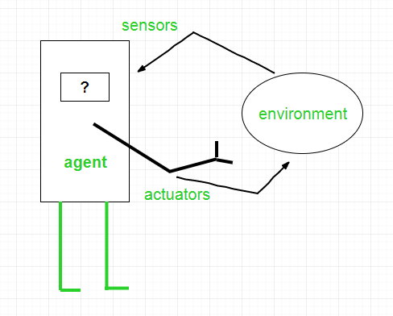
To understand the structure of Intelligent Agents, we should be familiar with Architecture and Agent programs.
Architecture is the machinery that the agent executes on.
It is a device with sensors and actuators, for example, a robotic car, a camera, a PC.
Agent program is an implementation of an agent function.
An agent function is a map from the percept sequence(history of all that an agent has perceived to date) to an action.
Agent = Architecture + Agent Program

Slide 4
Examples of Agents
A software agent has Keystrokes, file contents, received network packages which act as sensors and displays on the screen, files, sent network packets acting as actuators.
A Human-agent has eyes, ears, and other organs which act as sensors, and hands, legs, mouth, and other body parts acting as actuators.
A Robotic agent has Cameras and infrared range finders which act as sensors and various motors acting as actuators.

Slide 5
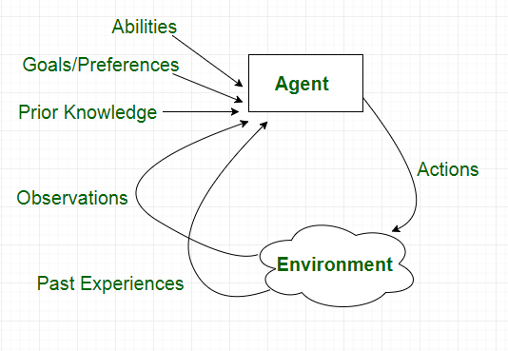

Slide 6
Types of AI Agents
Simple Reflex Agent
Model-based reflex agent
Goal-based agents
Utility-based agent
Learning agent

Slide 7
Simple Reflex Agent
The Simple reflex agents are the simplest agents.
They take decisions on the basis of the current percepts and ignore the rest of the percept history.
These agents only succeed in the fully observable environment.
The Simple reflex agent does not consider any part of percepts history during their decision and action process.
The Simple reflex agent works on Condition-action rule, which means it maps the current state to action. Such as a Room Cleaner agent, it works only if there is dirt in the room.

Slide 8
ENVIRONMENT
AGENT
Sensors
What the world is now like?
Condition – Action Rule
What action should I do now?
Actuator

Slide 9
Limitations of Simple Reflex
Intelligence level is very limited
Works only on Fully Observable Environment
Does not hold any knowledge or information of non-perceptual parts of state
Because of the static knowledge based: it is usually too big to generate and store
Collection of rules are required to be updated if any change happens in the environment

Slide 10
Model-based Reflex Agent
The Model-based agent can work in a partially observable environment, and track the situation.
A model-based agent has two important factors:
Model: It is knowledge about "how things happen in the world," so it is called a Model-based agent.
Internal State: It is a representation of the current state based on percept history.
These agents have the model, "which is knowledge of the world" and based on the model they perform actions.
Updating the agent state requires information about:
How the world evolves
How the agent's action affects the world.

Slide 11
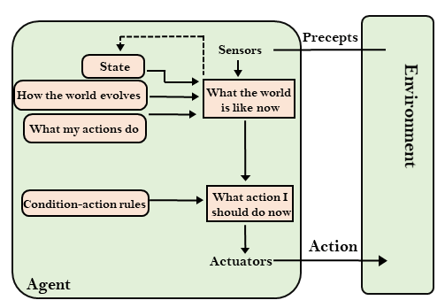

Slide 12
Goal Based Agents
The knowledge of the current state environment is not always sufficient to decide for an agent to what to do.
The agent needs to know its goal which describes desirable situations.
Goal-based agents expand the capabilities of the model-based agent by having the "goal" information.
They choose an action, so that they can achieve the goal.
These agents may have to consider a long sequence of possible actions before deciding whether the goal is achieved or not. Such considerations of different scenario are called searching and planning, which makes an agent proactive.

Slide 13
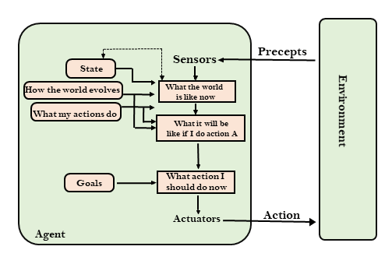

Slide 14
Utility Based Agents
These agents are similar to the goal-based agent but provide an extra component of utility measurement which makes them different by providing a measure of success at a given state.
Utility-based agent act based not only goals but also the best way to achieve the goal.
The Utility-based agent is useful when there are multiple possible alternatives, and an agent has to choose in order to perform the best action.
The utility function maps each state to a real number to check how efficiently each action achieves the goals.

Slide 15
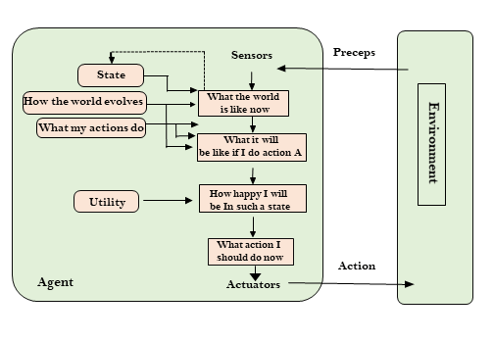

Slide 16

Learning Agents
A learning agent in AI is the type of agent which can learn from its past experiences, or it has learning capabilities.
It starts to act with basic knowledge and then able to act and adapt automatically through learning.
A learning agent has mainly four conceptual components, which are:
Performance Element
The Critic
The Learning Element
The Problem Generator

Slide 17
The Performance Element
The performance element takes in the percept & settle on a suitable action similar to a non-learning agent
The performance element which is in charge of choosing external action
Same element that has been initially considered to be the whole agent
Takes in percept and decides on action
The Critic
Is the one using a fixed standard of performance to make the learning element understand as to how well the agent is performing
Learning element uses feedback received from the critic on the performance of the agent and decides the change of execution to improve the situation in future

Slide 18
The Learning Element
Receives the data from critics and makes proper upgrades to the performance element
The learning element utilizes feedback from the critic on how the agent is getting along and decides how execution is adjusted to improve the situation in future
Plan of the learning element relies particularly on the outline of the performance element
The Problem Generator
Suggests action that will lead to new and informative experiences
It is in charge of recommending action that will prompt new and educational experience
If performance element has its direction, it will continue doing the action what are best given and what it knows

Slide 19
Intelligent Agent Application
System and Network Management
Information Access and Management
Work Flow and Administrative Management
Customer Helpdesk
Personal Shopping Assistant

